Slide 1
MARKETING CAMPAIGN ANALYSIS
ANIL RAJU

Slide 2
OBJECTIVE
Identify the marketing campaign that maximizes the sales for the store.
Identify age groups for potential future customer acquisition campaigns for sales growth.

Slide 3
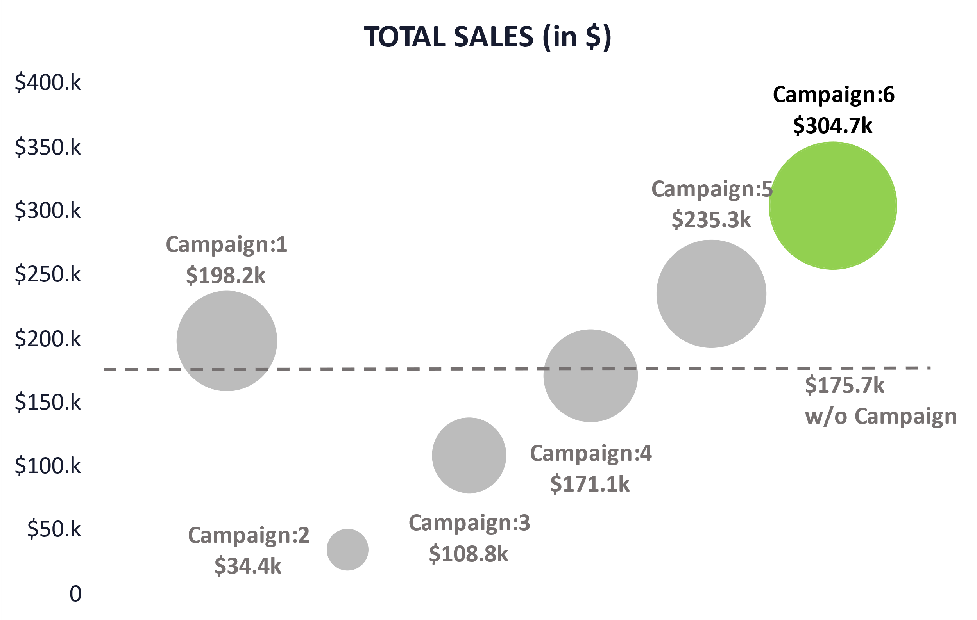
Campaign 6 has demonstrated its capability to maximize sales for the store.
Campaign: 6 achieved the highest sales ($304.7k) in the trial. It’s a substantial 30% increase over the next best-performing campaign.
The campaign ranks second to last in terms of average per customer sales($980/customer). It’s about 40% lower than the highest average per customer sales (from Campaign: 5).
One key factor contributing to Campaign: 6's higher total sales was its ability to capture approximately 15% of the customer base. In contrast Campaign 5 and 1 both struggled with roughly 50% lower customer capture rates.
The customer base captured through the campaign had a very close resemblance to the trial base especially in the income bracket.
$175.7k sales is from customers who did not use any of the campaign offer

Slide 4
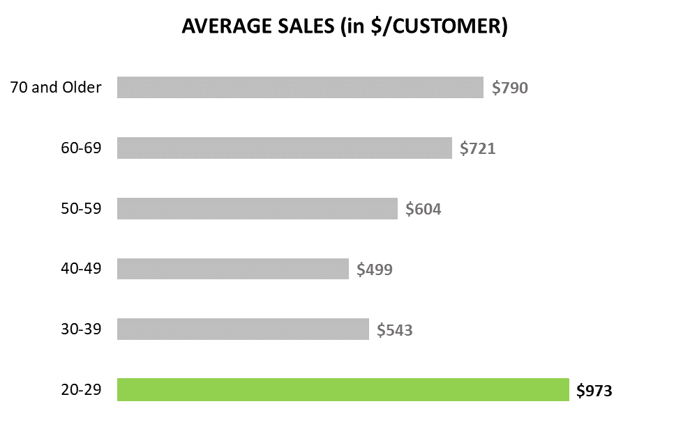
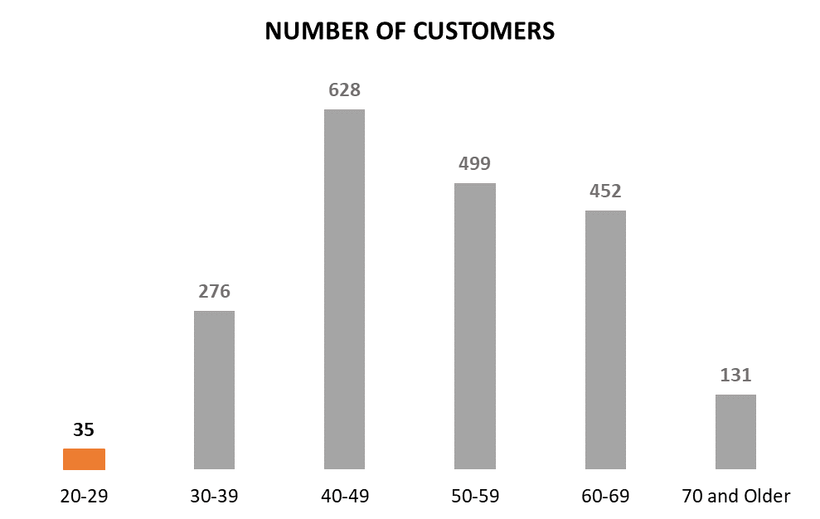
Age group “20-29” is an ideal candidate for future customer acquisition campaigns
Throughout each campaign, the average sales per customer within the “20-29” age group has consistently exceeded or matched the performance of other age groups.
Overall average sales confirm that the age group “20-29” has per customer sales worth $973, about 23% higher than the next best age group.
The age group also has the fewest number of customers. It’s nearly 64% lower than the next largest age group.
With robust customer loyalty among all age groups. Given the promising sales performance, targeting this age group is expected to yield continued sales growth in the coming years.

Slide 5
Thank You

Slide 6
Appendix

Slide 7
Appendix – I Data Cleaning
“Marital Status” and “Education Status” variables were created to consolidate data into a single categorical variable from their respective columns.
“Age Brackets”, “Income Bracket”, “Last Purchase”, “Website Visits(per week)”, “Customer Loyalty” and “Customer Complain” were converted into categorical variables to assist with the analysis.
The categorical levels for the above mentioned variables are self explanatory but for more clarification refer to Appendix-II.
Total 26 variables from the provided list of variables is considered for the analysis, selected based on the number of available description for the variables.
184 duplicate entries were removed from the analysis.

Slide 8
Appendix – II Categorical Variables
Age Brackets – 6 levels; tracks the customers age, level “20-29” for ages between 20 to 29, levels go up till “70 and older”.
Education Status – 5 levels; it records the customers education level: “2nd Cycle”, “Basic”, “Graduation”, “Master” and “PhD”.
Marital Status – 5 levels; it tracks the customers marital status as: “Single”, “Together”, “Married”, “Divorced”, “Widow”.
Income Bracket – 3 levels; the customers yearly income is categorized as “1.Low Income” for income less than $43,783, “2.Mid Income” for income between $43,783 and $64,856 & “3.High Income” for income above $64,856.
Last Purchase – 3 levels; it is categorized as “<1 month” if the last purchase was made within a month, “1-2months” when within 1-2 months and “>2 months” when more than 2 months have passed since the last purchase.
Website Visits – 4 levels; “<5times” is when the customer visits the website for less than 5 times a week, “5-10times”, “11-15times” and “16times and more” are counting the number of visits to the website as respectively mentioned in the levels.
Customer Complain – 2 levels; “Yes” if the customer has raised any complains in the last 2 years or “No” otherwise.
Customer Loyalty – 3 levels; “4-6 years” when the customer has been using the companies service for the past 4 to 6 years, “6-7 years” and “7-8 years” are counting the number of years with the company respectively.

Slide 9
Appendix – III Campaign Analysis

Slide 10
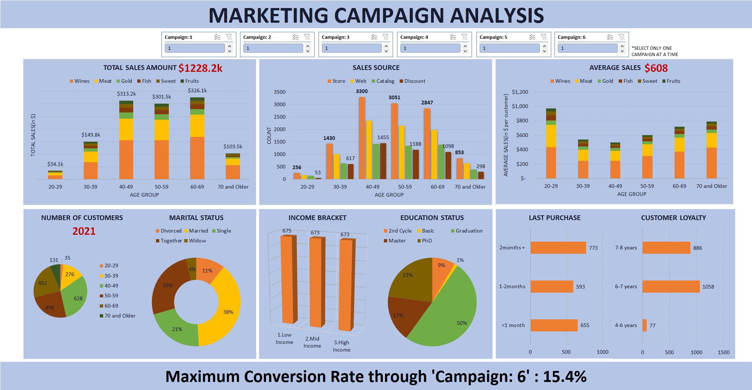
MARKETING CAMPAIGN ANALYSIS SUMMARY
The combined sales transaction value during the study is $1228.2k with an average sale per customer about $608; young customers aged 20-29 spending the most.
We have 2021 customers in the sample and of which 1366 customers haven’t purchased for more than a month.
Campaign: 6 has the highest conversion rate from our sample study.
Notes:
NOTE:
The combined sales transaction value during the study is $1228.2k
We see a 2x the total sales amount and number of sales from customer ages between 40-69.
Majorly contributed by wine, meat and gold sale across all age group.
The sales occurred mostly through stores and websites with an average sale per customer about $608 with young customers aged 20-29 spending the most.
We have 2021 customers in the sample, about 80% of them between 40-69 years old, majorly couples and most of them posses a graduate or higher education.
Note the number of customers in income brackets, last purchase and customer loyalty for future campaign analysis.
There are potentially 1366(=593+773) customers that could be captured from the past customers that haven’t purchased anything for a month.
Campaign: 6 has the highest conversion rate from our study of 2021 customers.
Catalog and Discount related sales were fairly identical among all age groups.
Income Brackets have equal population.
Half of the customer base is a “Graduate”. The “Basic” and “2nd Cycle” is only 10% of the overall.
We have more loyal customers i.e. customers for more than 6 years.
The “last purchase” levels have an approximately uniform distribution.

Slide 11
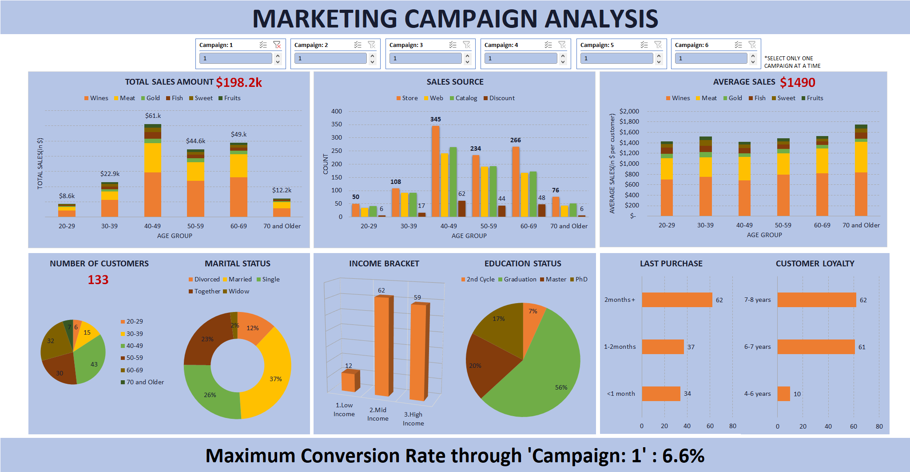
MARKETING “CAMPAIGN : 1” ANALYSIS
The “Campaign:1” sales transaction value is $198.2k with an average sale per customer about $1490 (a 145% increase from the overall average of $608).
133 customers responded to the campaign i.e. a 6.6% conversion rate.
The campaign captured 99 customers from the 1366 customers who hasn’t purchased for more than a month.
Notes:
NOTE:
The “Campaign:1” total sales transaction value is $198.2k. The sales occurred mostly through stores, websites and catalog.
An average sale per customer at $1490 (a 145% increase from the overall average of $608). Note the almost similar average spending from all age groups and also higher than the overall average.
We have 133 customers i.e. a 6.6% conversion rate with customer demographic features very similar to the overall sample except that the campaign is able to capture the middle income and higher customers more, probably helping with the higher per customer sales.
The campaign captured about 99 old customers(7% of 1366 customers) who hasn’t purchased anything for more than a month to purchase goods.

Slide 12
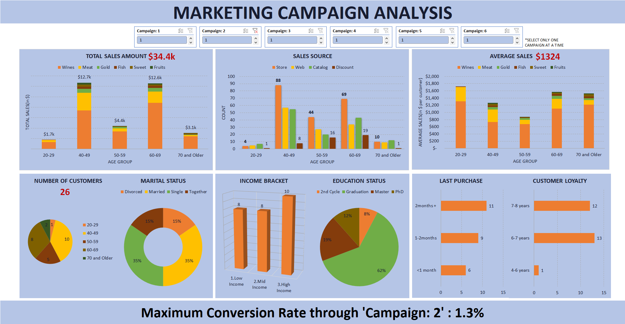
MARKETING “CAMPAIGN : 2” ANALYSIS
The “Campaign:2” sales transaction value is $34.4k with an average sale per customer about $1324 (a 118% increase from the overall average of $608).
26 customers responded to the campaign i.e. a 1.3% conversion rate.
The campaign captured 20 customers from the 1366 customers who hasn’t purchased for more than a month.
Notes:
NOTE:
The “Campaign:2” total sales transaction value is $34.4k. The sales occurred mostly through stores, websites and catalog.
An average sale per customer at $1324 (118% increase). Note the higher average spending from all the age groups with the highest from the “20-29” age group.
We have 26 customers i.e. a 1.3% conversion rate. Note a single customer within “20-29” age group, no one from “30-39” age group and also there are more customers from the higher income bracket probably the cause for higher average sales. Marital and Education status also have similar disproportionate distribution among their levels.
The campaign captured about 20 old customers(1.5%) to purchase goods.

Slide 13
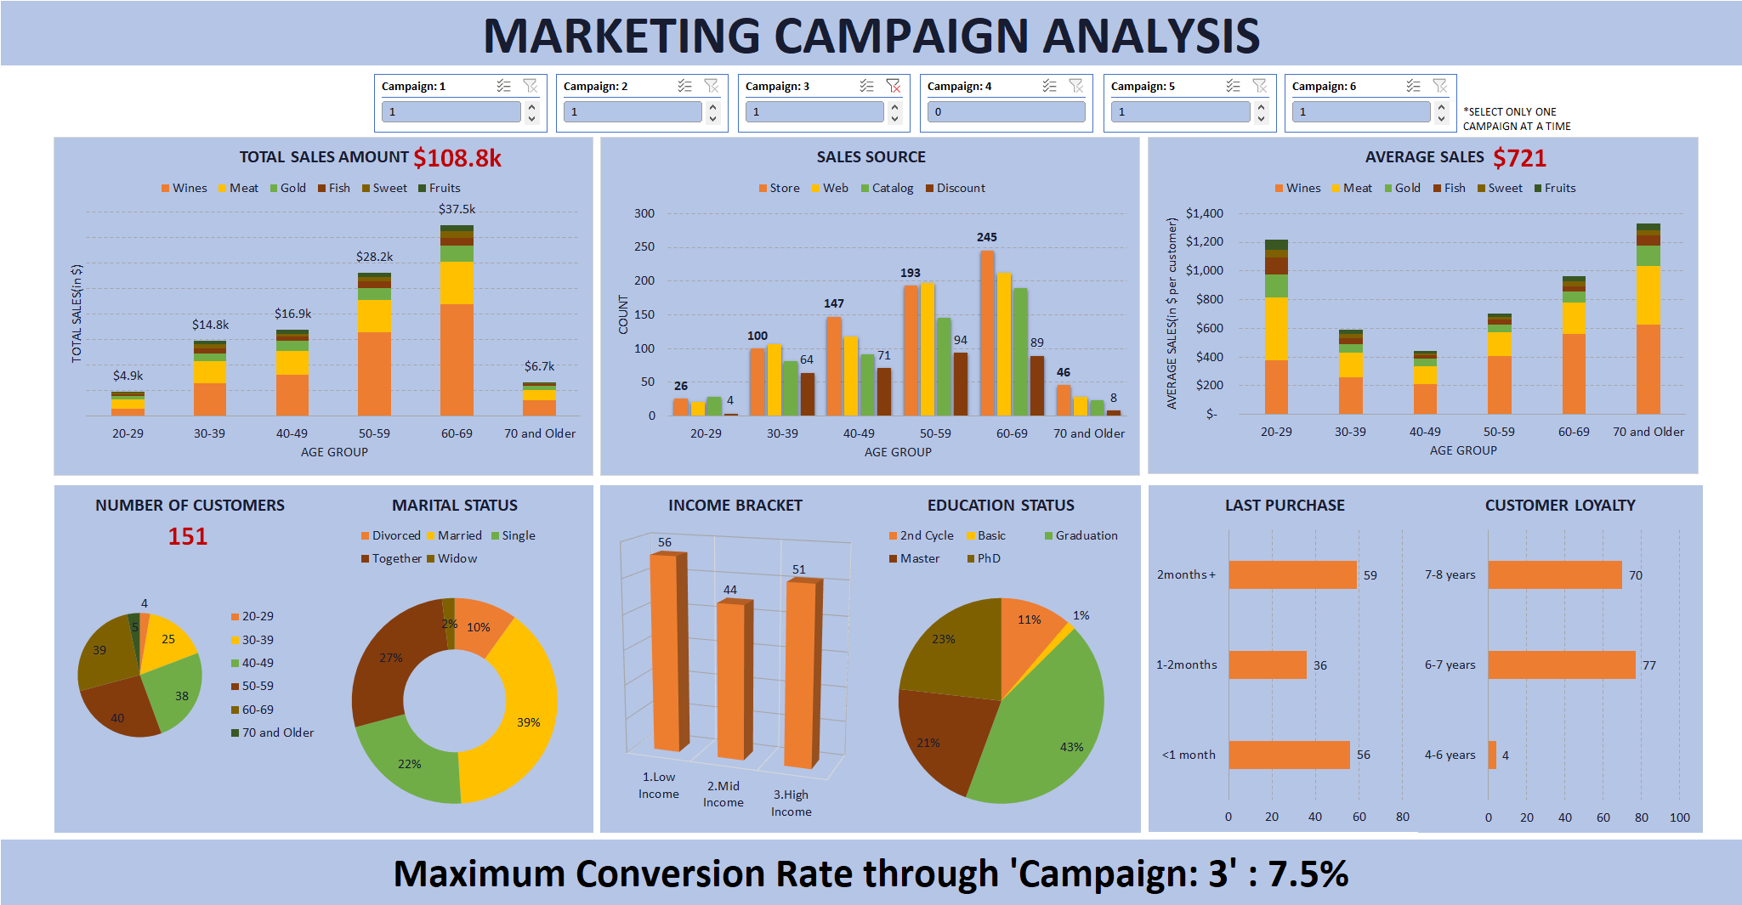
MARKETING “CAMPAIGN : 3” ANALYSIS
The “Campaign:3” sales transaction value is $108.8k with an average sale per customer about $721 (an 18% increase from the overall average of $608).
151 customers responded to the campaign i.e. a 7.5% conversion rate.
The campaign captured 95 customers from the 1366 customers who hasn’t purchased for more than a month.
Notes:
NOTE:
The “Campaign:3” total sales transaction value is $108.8k. The sales occurred mostly through stores, websites and catalog.
An average sale per customer at $721 (18% increase). Note the higher average spending from the age groups “20-29” and “70 and Older”.
We have 151 customers i.e. a 7.5% conversion rate. The customer demographics have very similar proportionate distribution among their levels as the overall status with a slightly more lower income customers.
The campaign captured about 95 old customers(7%) to purchase goods.

Slide 14
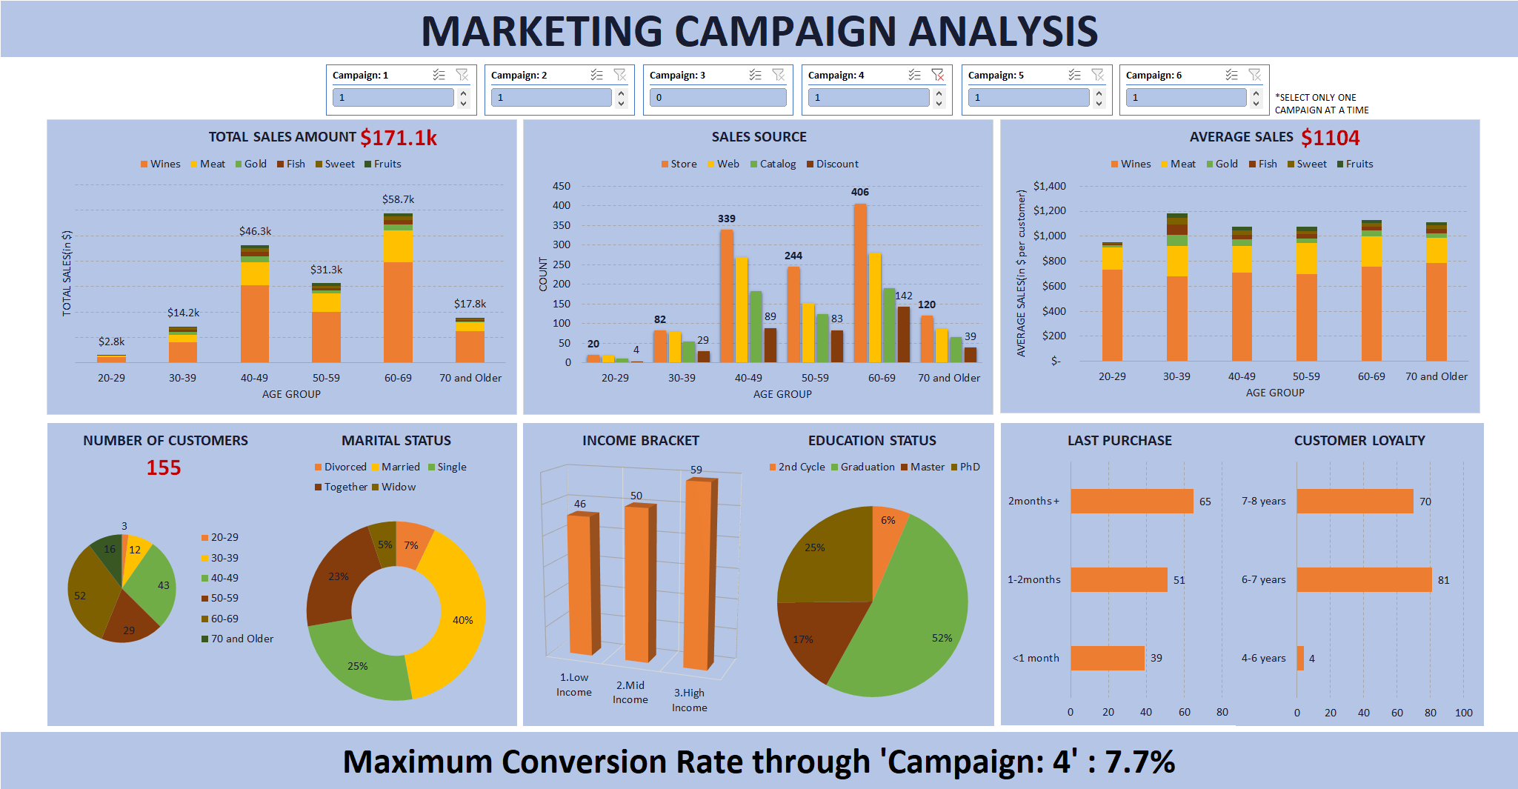
MARKETING “CAMPAIGN : 4” ANALYSIS
The “Campaign:4” sales transaction value is $171.1k with an average sale per customer about $1104 (an 81% increase from the overall average of $608).
155 customers responded to the campaign i.e. a 7.7% conversion rate.
The campaign captured 116 customers from the 1366 customers who hasn’t purchased for more than a month.
Notes:
NOTE:
The “Campaign:4” total sales transaction value is $171.1k. The sales occurred mostly through stores, websites and catalog.
An average sale per customer at $1104 (81% increase). Note the similar and higher average spending from all the age groups.
We have 155 customers i.e. a 7.7% conversion rate. We have a lot more customers that are age 60 and older and also with higher income. The rest of the customer demographics have very similar proportionate distribution among their levels as the overall status.
The campaign captured about 116 old customers(8.5%) to purchase goods.

Slide 15
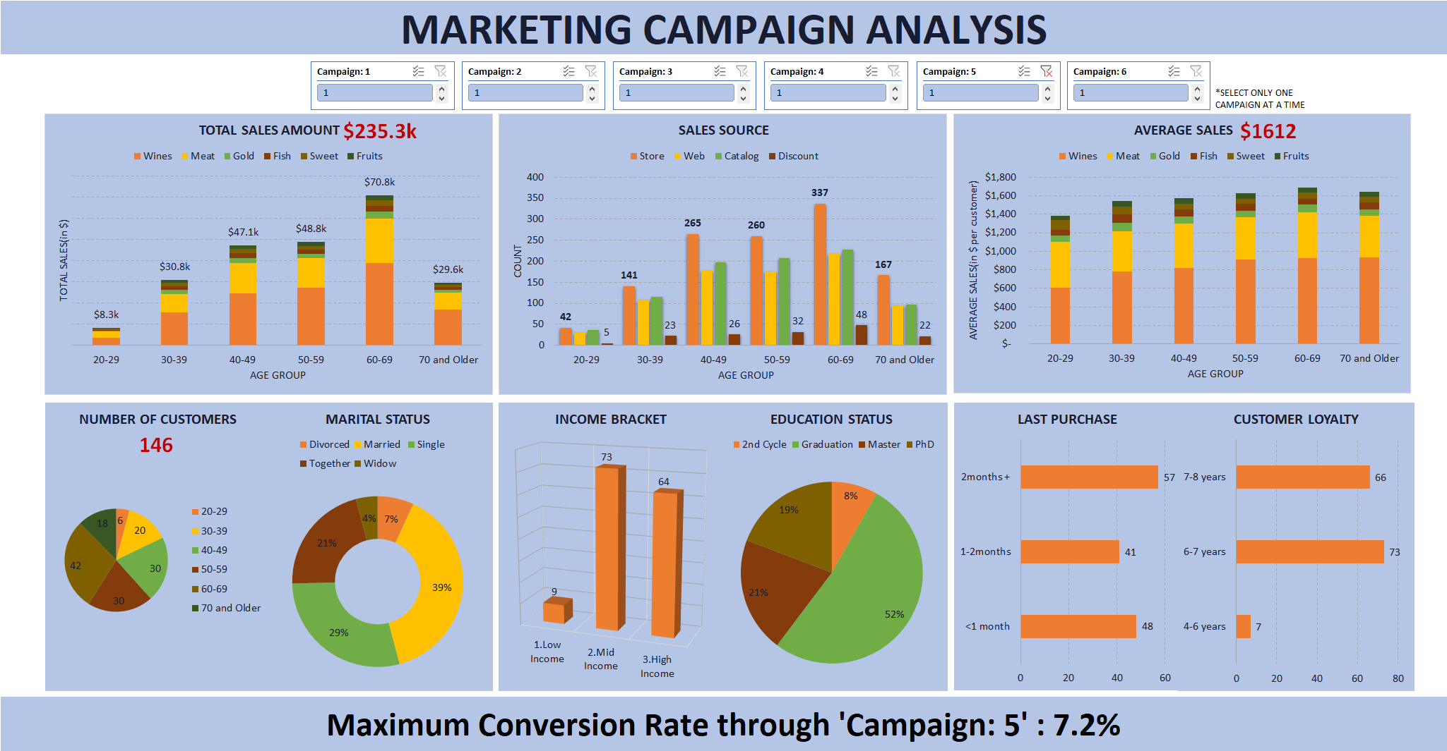
MARKETING “CAMPAIGN : 5” ANALYSIS
The “Campaign:5” sales transaction value is $235.3k with an average sale per customer about $1612 (a 165% increase from the overall average of $608).
146 customers responded to the campaign i.e. a 7.2% conversion rate.
The campaign captured 98 customers from the 1366 customers who hasn’t purchased for more than a month.
Notes:
NOTE:
The “Campaign:5” total sales transaction value is $235.3k. The sales occurred mostly through stores, catalog and websites.
An average sale per customer at $1612 (165% increase). Note the similar and higher average spending from all the age groups.
We have 146 customers i.e. a 7.2% conversion rate. We have a lot less customers that are age 40-59 and also customers with lower income. The rest of the customer demographics have very similar proportionate distribution among their levels as the overall status.
The campaign captured about 98 old customers(7.2%) to purchase goods.

Slide 16
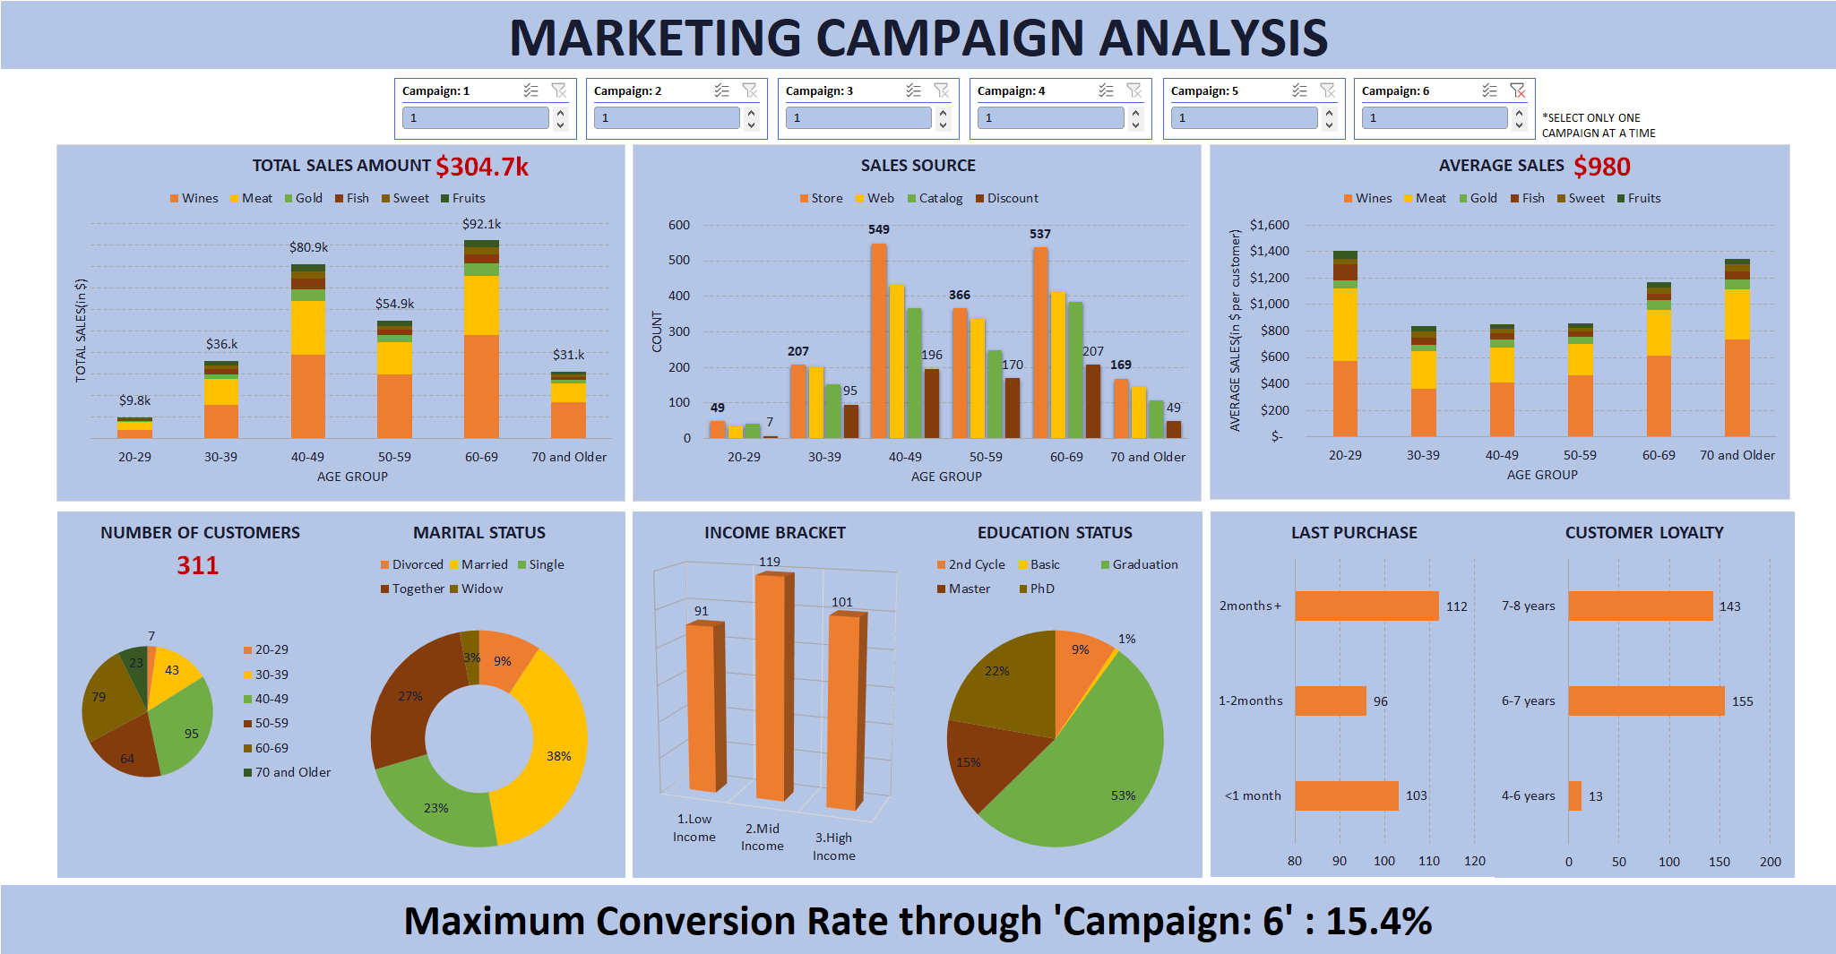
MARKETING “CAMPAIGN : 6” ANALYSIS
The “Campaign:6” sales transaction value is $304.7k with an average sale per customer about $980 (a 61% increase from the overall average of $608).
311 customers responded to the campaign i.e. a 15.4% conversion rate.
The campaign captured 208 customers from the 1366 customers who hasn’t purchased for more than a month.
Notes:
NOTE:
The “Campaign:6” total sales transaction value is $304.7k. The sales occurred mostly through stores, websites and catalog.
An average sale per customer at $980 (61% increase). Note the higher average spending especially from the age group “20-29”.
We have 311 customers i.e. a 15.4% conversion rate. We have a lot less customers that are age “50-59” but a bit higher mid income customers. The rest of the customer demographics have very similar proportionate distribution among their levels as the overall status.
The campaign captured about 208 old customers(15%) to purchase goods.

